Slide 1
3. Sample Statistics

Slide 2
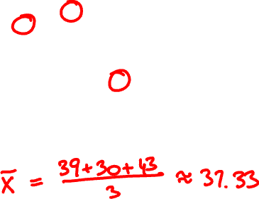
What is the average exam grade?
59
62
57
59
55
55
53
56
44
56
46
49
53
50
52
46
46
44
51
48
52
38
46
45
45
39
42
49
45
44
39
41
37
46
40
44
41
40
32
44
49
35
36
31
32
46
30
35
45
41
33
33
37
42
39
34
35
37
43
38
42
27
36
39
38
37
33
33
40
44
25
32
28
43
33
37
40
39
30
25
25
24
32
23
23
31
28
19
34
39
23
37
32
24
28
33
22
31
24
33
30
31
26
25
34
20
23
28
21
28
22
15
31
25
21
21
29
29
21
15
20
29
30
20
29
18
27
19
36
16
15
32
24
13
15
20
15
20
26
26
16
15
29
27
6
12
16
5
7
11
13
15

Slide 3
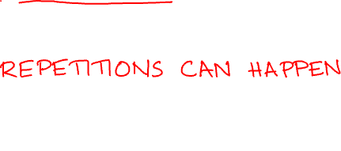
A random sample is a joint outcome of n independent random variables X₁, X₂, …, X_{n} with same PDF/PMF
The sample mean is the random variable
X₁ + X₂ + … + X_{n}
X =
n

Slide 4

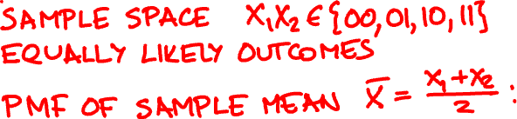

Data is Indicator(1/2). What is actual mean μ?
x 0 1
P(Indicator(p) = x) 1- p p
Take 2 samples. What is the PMF of X?

Slide 5
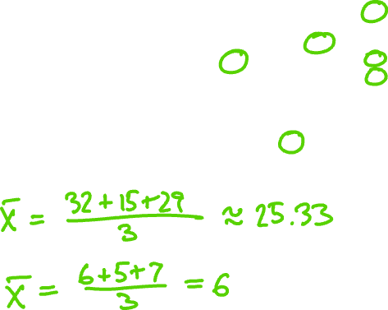
What if I had chosen a different sample?
59
62
57
59
55
55
53
56
44
56
46
49
53
50
52
46
46
44
51
48
52
38
46
45
45
39
42
49
45
44
39
41
37
46
40
44
41
40
32
44
49
35
36
31
32
46
30
35
45
41
33
33
37
42
39
34
35
37
43
38
42
27
36
39
38
37
33
33
40
44
25
32
28
43
33
37
40
39
30
25
25
24
32
23
23
31
28
19
34
39
23
37
32
24
28
33
22
31
24
33
30
31
26
25
34
20
23
28
21
28
22
15
31
25
21
21
29
29
21
15
20
29
30
20
29
18
27
19
36
16
15
32
24
13
15
20
15
20
26
26
16
15
29
27
6
12
16
5
7
11
13
15

Slide 6

The sample mean is an estimator of the actual mean μ = E[X₁] = … = E[X_{n}]
How close is X to actual value μ?
P(|X – μ| ≥ ε) ≤ δ

Slide 7
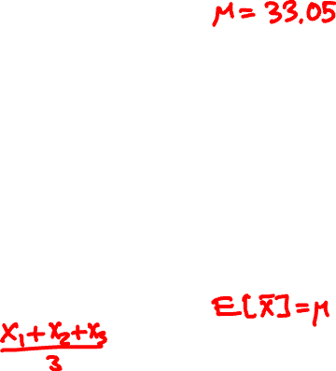
data histogram
histogram of X
(n = 3)

Slide 8
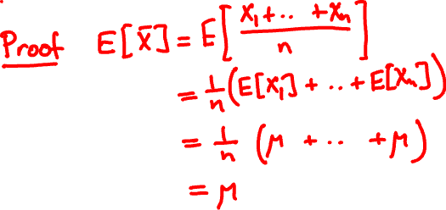
Properties of sample mean
Unbiased: For every n
E[X] = μ

Slide 9

histogram of X
n = 3
histogram of X
n = 9

Slide 10
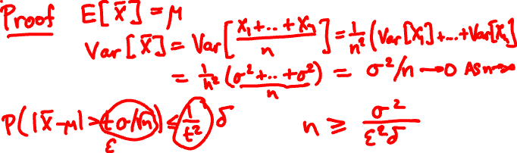
Properties of sample mean
Consistent:
For every ε, δ and sufficiently large* n
P(|X – μ| ≥ ε) ≤ δ

Slide 11
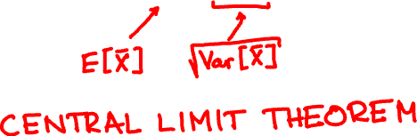
Properties of sample mean
Asymptotically normal deviation:
For every t
lim P(X ≤ μ + tσ/√n ) = P(Normal(0, 1) ≤ t)
n → ∞

Slide 12
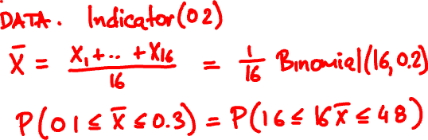

In a population of 1000, 200 have disease X.
For a sample of size 16, what is probability the sample mean is in range 10% to 30%?

Slide 13

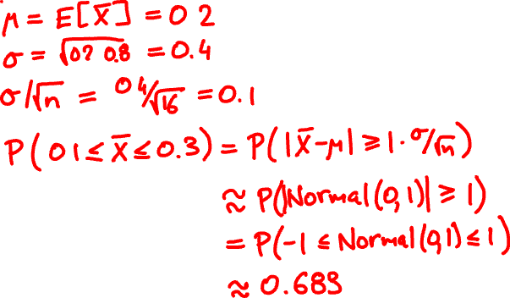
What would the central limit theorem say?

Slide 14
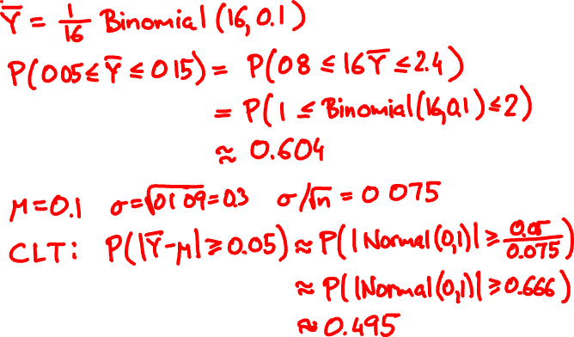

Out of 1000, 100 have disease Y. What is P(5% ≤ Y ≤ 15%)?

Slide 15
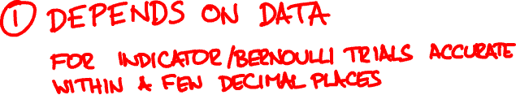


Central rule of thumb
If n > 30, CLT usually* works.

Slide 16
Sample statistics
Given sample X₁, X₂, …, X_{n}, let Samp take these values equally likely
sample mean:
X₁ + X₂ + … + X_{n}
X = E[Samp] =
n
sample variance:
V = Var[Samp] = E[(Samp – X)²]
(X₁ – X)² + … + (X_{n} – X)²
=
n

Slide 17
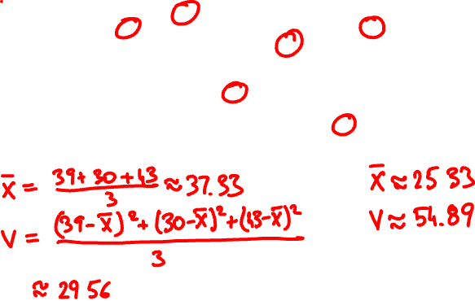
Some sample variances
59
62
57
59
55
55
53
56
44
56
46
49
53
50
52
46
46
44
51
48
52
38
46
45
45
39
42
49
45
44
39
41
37
46
40
44
41
40
32
44
49
35
36
31
32
46
30
35
45
41
33
33
37
42
39
34
35
37
43
38
42
27
36
39
38
37
33
33
40
44
25
32
28
43
33
37
40
39
30
25
25
24
32
23
23
31
28
19
34
39
23
37
32
24
28
33
22
31
24
33
30
31
26
25
34
20
23
28
21
28
22
15
31
25
21
21
29
29
21
15
20
29
30
20
29
18
27
19
36
16
15
32
24
13
15
20
15
20
26
26
16
15
29
27
6
12
16
5
7
11
13
15

Slide 18
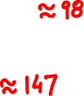
average sample variance E[V]
actual data variance σ²
histogram of sample variance V for n = 3

Slide 19
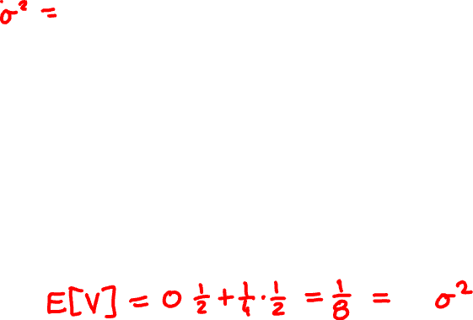
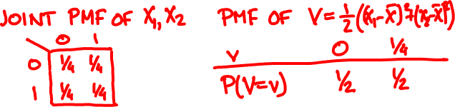
Data is Indicator(1/2). What is σ²?
Var(Indicator(p)) = p(1- p)
Take 2 samples. What is the PMF of V?

Slide 20
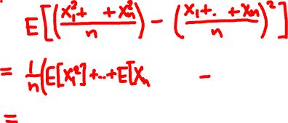
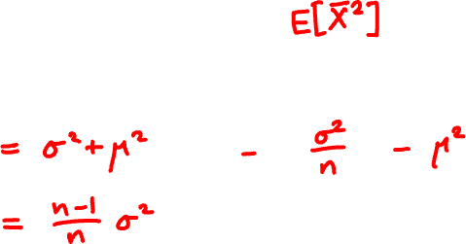
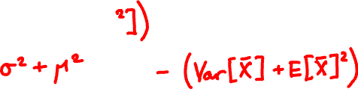
E[V] =

Slide 21


n
(X₁ – X)² + … + (X_{n} – X)²
S² =
Var[Samp]
=
n – 1
n – 1
is an unbiased estimator of actual variance σ²

Slide 22
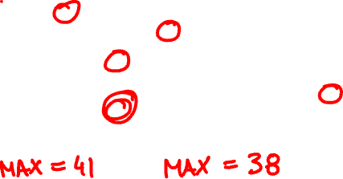
What about the sample maximum?
59
62
57
59
55
55
53
56
44
56
46
49
53
50
52
46
46
44
51
48
52
38
46
45
45
39
42
49
45
44
39
41
37
46
40
44
41
40
32
44
49
35
36
31
32
46
30
35
45
41
33
33
37
42
39
34
35
37
43
38
42
27
36
39
38
37
33
33
40
44
25
32
28
43
33
37
40
39
30
25
25
24
32
23
23
31
28
19
34
39
23
37
32
24
28
33
22
31
24
33
30
31
26
25
34
20
23
28
21
28
22
15
31
25
21
21
29
29
21
15
20
29
30
20
29
18
27
19
36
16
15
32
24
13
15
20
15
20
26
26
16
15
29
27
6
12
16
5
7
11
13
15

Slide 23


histogram of sample maximum for n = 3

